Slide 1
ELECTVIZ Election Data Visualization for media
Infosys Springboard Internship 6.0 | Final Project Presentation
Project mentor - nityashri s. j.
Presented by – Team C
ASHISH RANSING | N. MANJUSHRI | VARSHITA P. D. | PRATHAM S. SALIAN | KANUKANTHI DEEPIKA

Slide 2


Project Overview
A broadcast-quality Election Intelligence Dashboard engineered for high-pressure newsroom environments and professional media analytics.
Comprehensive 5-page interactive dashboard
Processes 400,000+ granular election records
Spans four decades of Indian political history (1977-2014)
Delivers seamless "Macro-to-Micro" analytical narrative
Powers real-time election intelligence for media professionals

Slide 3

The Challenge
Media analysts needed a comprehensive tool to transform vast election data into actionable intelligence.
Raw datasets lacking critical derived metrics
High naming inconsistency across political entities
Missing visual assets (party logos, standardized colors)
Need for instant national-to-constituency analysis
Requirement for broadcast-ready visualizations

Slide 4

Project Objectives
Historical Archiving: Standardize and visualize 400,000+ election records from 1977 to 2014
Metric Innovation: Engineer hidden metrics like Strike Rate, Winning Margin, and Voter Turnout %
Media-Ready Storytelling: Create visual narratives featuring "Nail-Biter" contests and "Landslide" victories
Real-Time Intelligence: Enable instant synthesis of national trends and regional battleground analysis
Strategic Asset: Provide critical tools for media analysts and live reporting

Slide 5

Technology Stack
LAYER | TECHNOLOGY SELECTED
ETL & Data Engineering | Python
Data Manipulation | Pandas, Numpy
Exploratory Analysis | Matplotlib, Seaborn
Visualization / BI | Microsoft Power BI
Data Storage | CSV (Flat Files) / Excel Files
IDE / Environment | Google Collab/ Jupyter Notebook
Version Control | Github/Gitlab

Slide 6

Data Sources & Processing
Dataset Link - https://www.kaggle.com/datasets/awadhi123/indian-election-dataset
Two primary high-volume datasets powering the system:
indian-national-level-election.csv - Lok Sabha data (1977-2014)
indian-state-level-election.csv - Detailed Vidhan Sabha data
400,000+ granular records processed and standardized
Custom Party_Master file with logos and HEX color codes
Python-driven normalization for data consistency

Slide 7

System Architecture
Schema Type
Fact Tables
Dimension Tables
Galaxy Schema (Multi-Fact Architecture)
indian-national-level-election.csv
indian-state-level-election.csv
Dim_State - Standardized state list
Dim_Year - Unified timeline dimension
Party_Master - Centralized branding repository

Slide 8

DAX Implementation
28+ Complex DAX Measures Engineered across the dashboard.
Strike Rate % - Campaign efficiency metrics
Vote Share % - Popularity analysis
Winning Margin - Victory strength indicators
Close Contests - Nail-biter identification (<5k votes)
Landslide Victories - Fortress seats (>100k margin)
Female Success Rate - Gender gap analysis

Slide 9

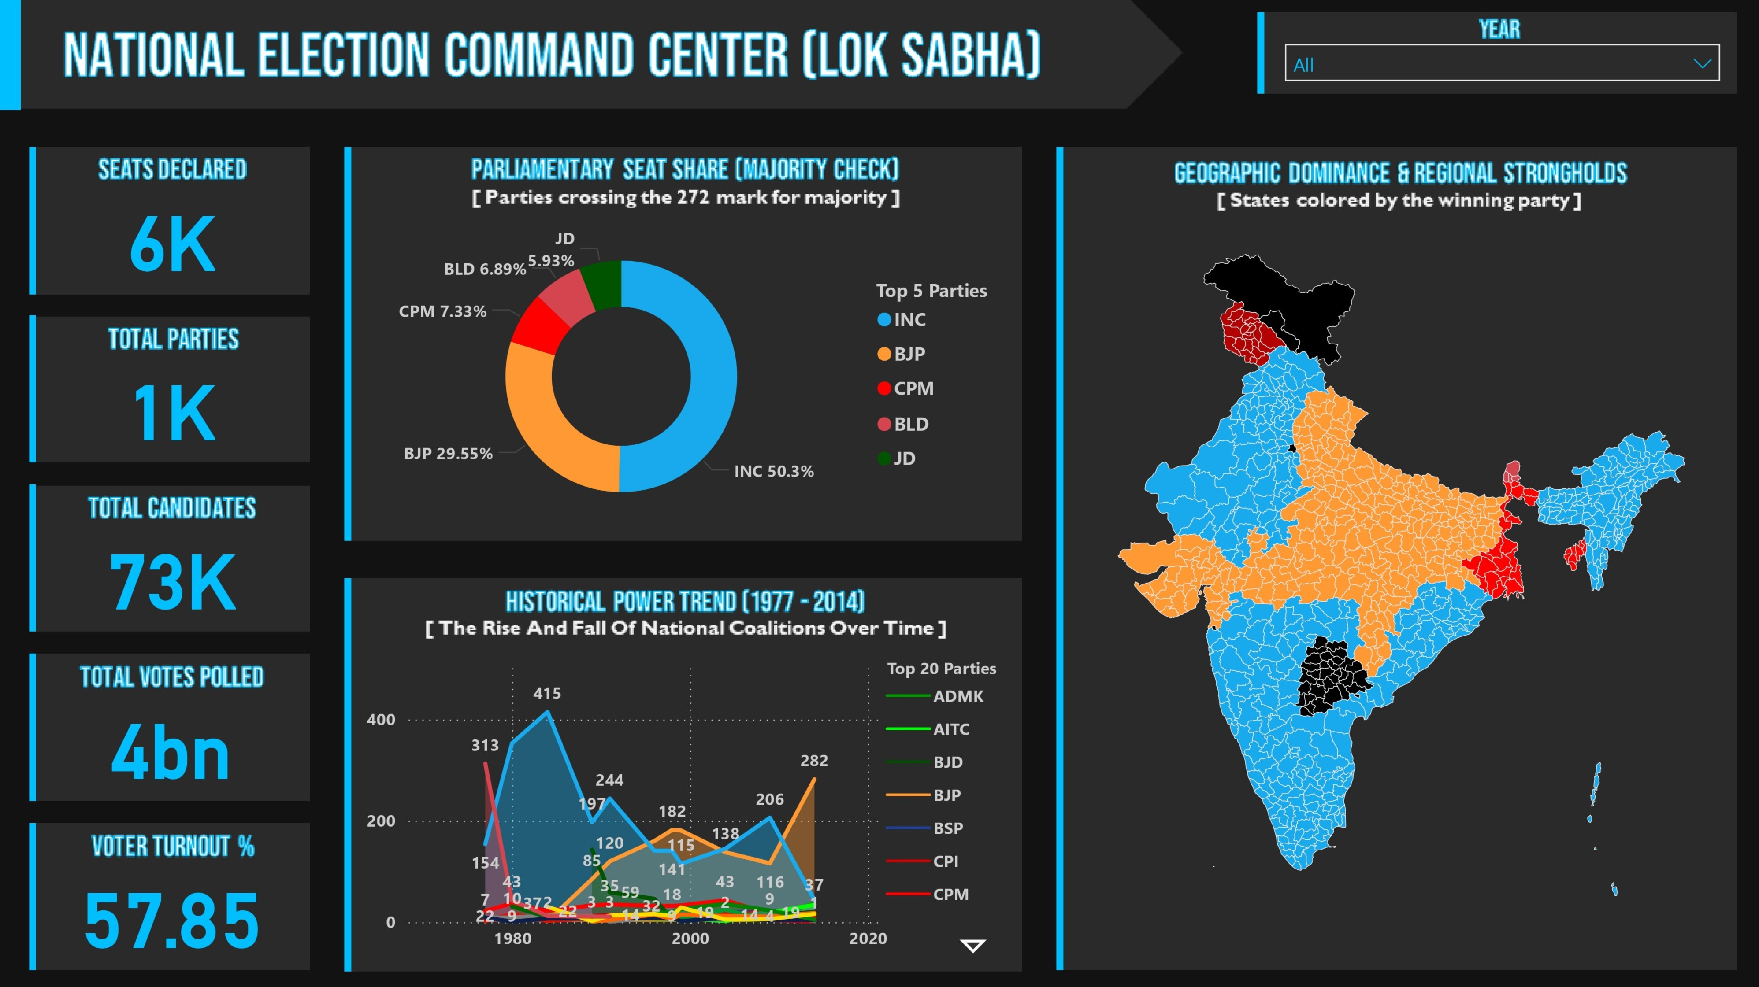
Module 1: National Command Center
Theme: The Macro View -High-level executive dashboard for instant government status visualization
Key Features:
Majority Gauge (272 seats threshold)
Historical Trend Analysis (1977-2014)
Geographic Dominance Heat Map
Key Performance Indicators

Slide 10

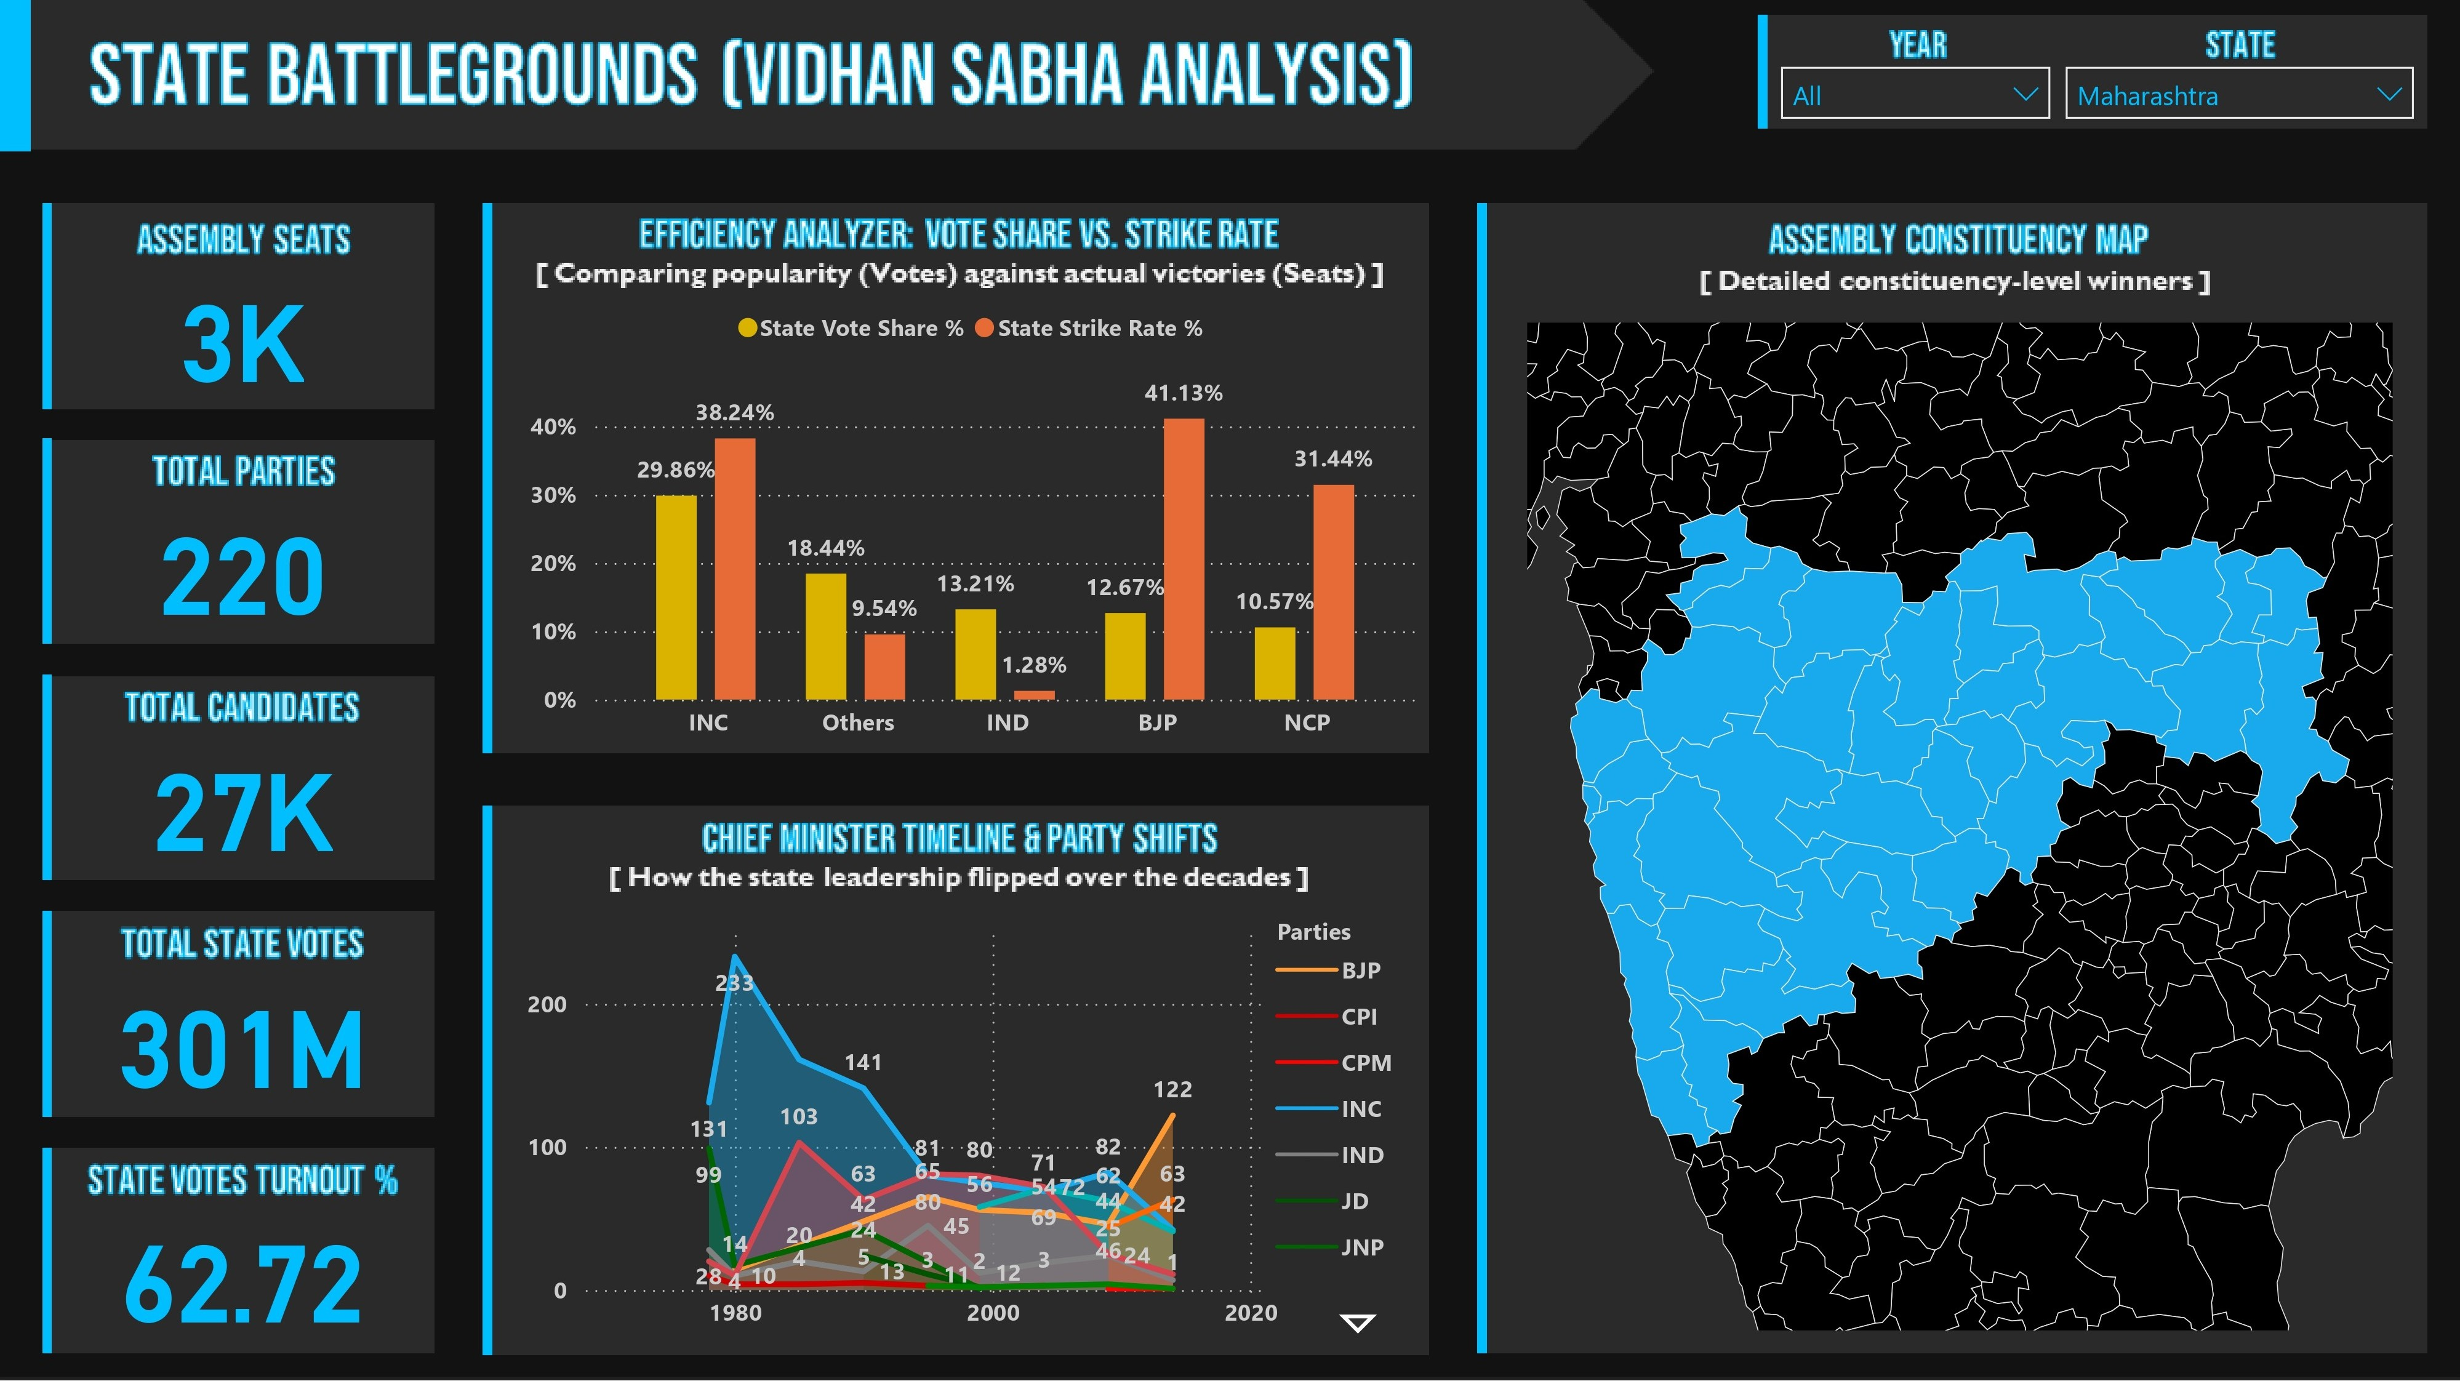
Module 2: State Battlegrounds
Theme: The Regional Deep Dive - Granular analysis of Legislative Assembly results and local efficiency
Key Features:
State-specific filtering capabilities
Efficiency Analyzer (Vote Share vs Strike Rate)
Leadership Timeline tracking
Assembly-level dominance maps

Slide 11

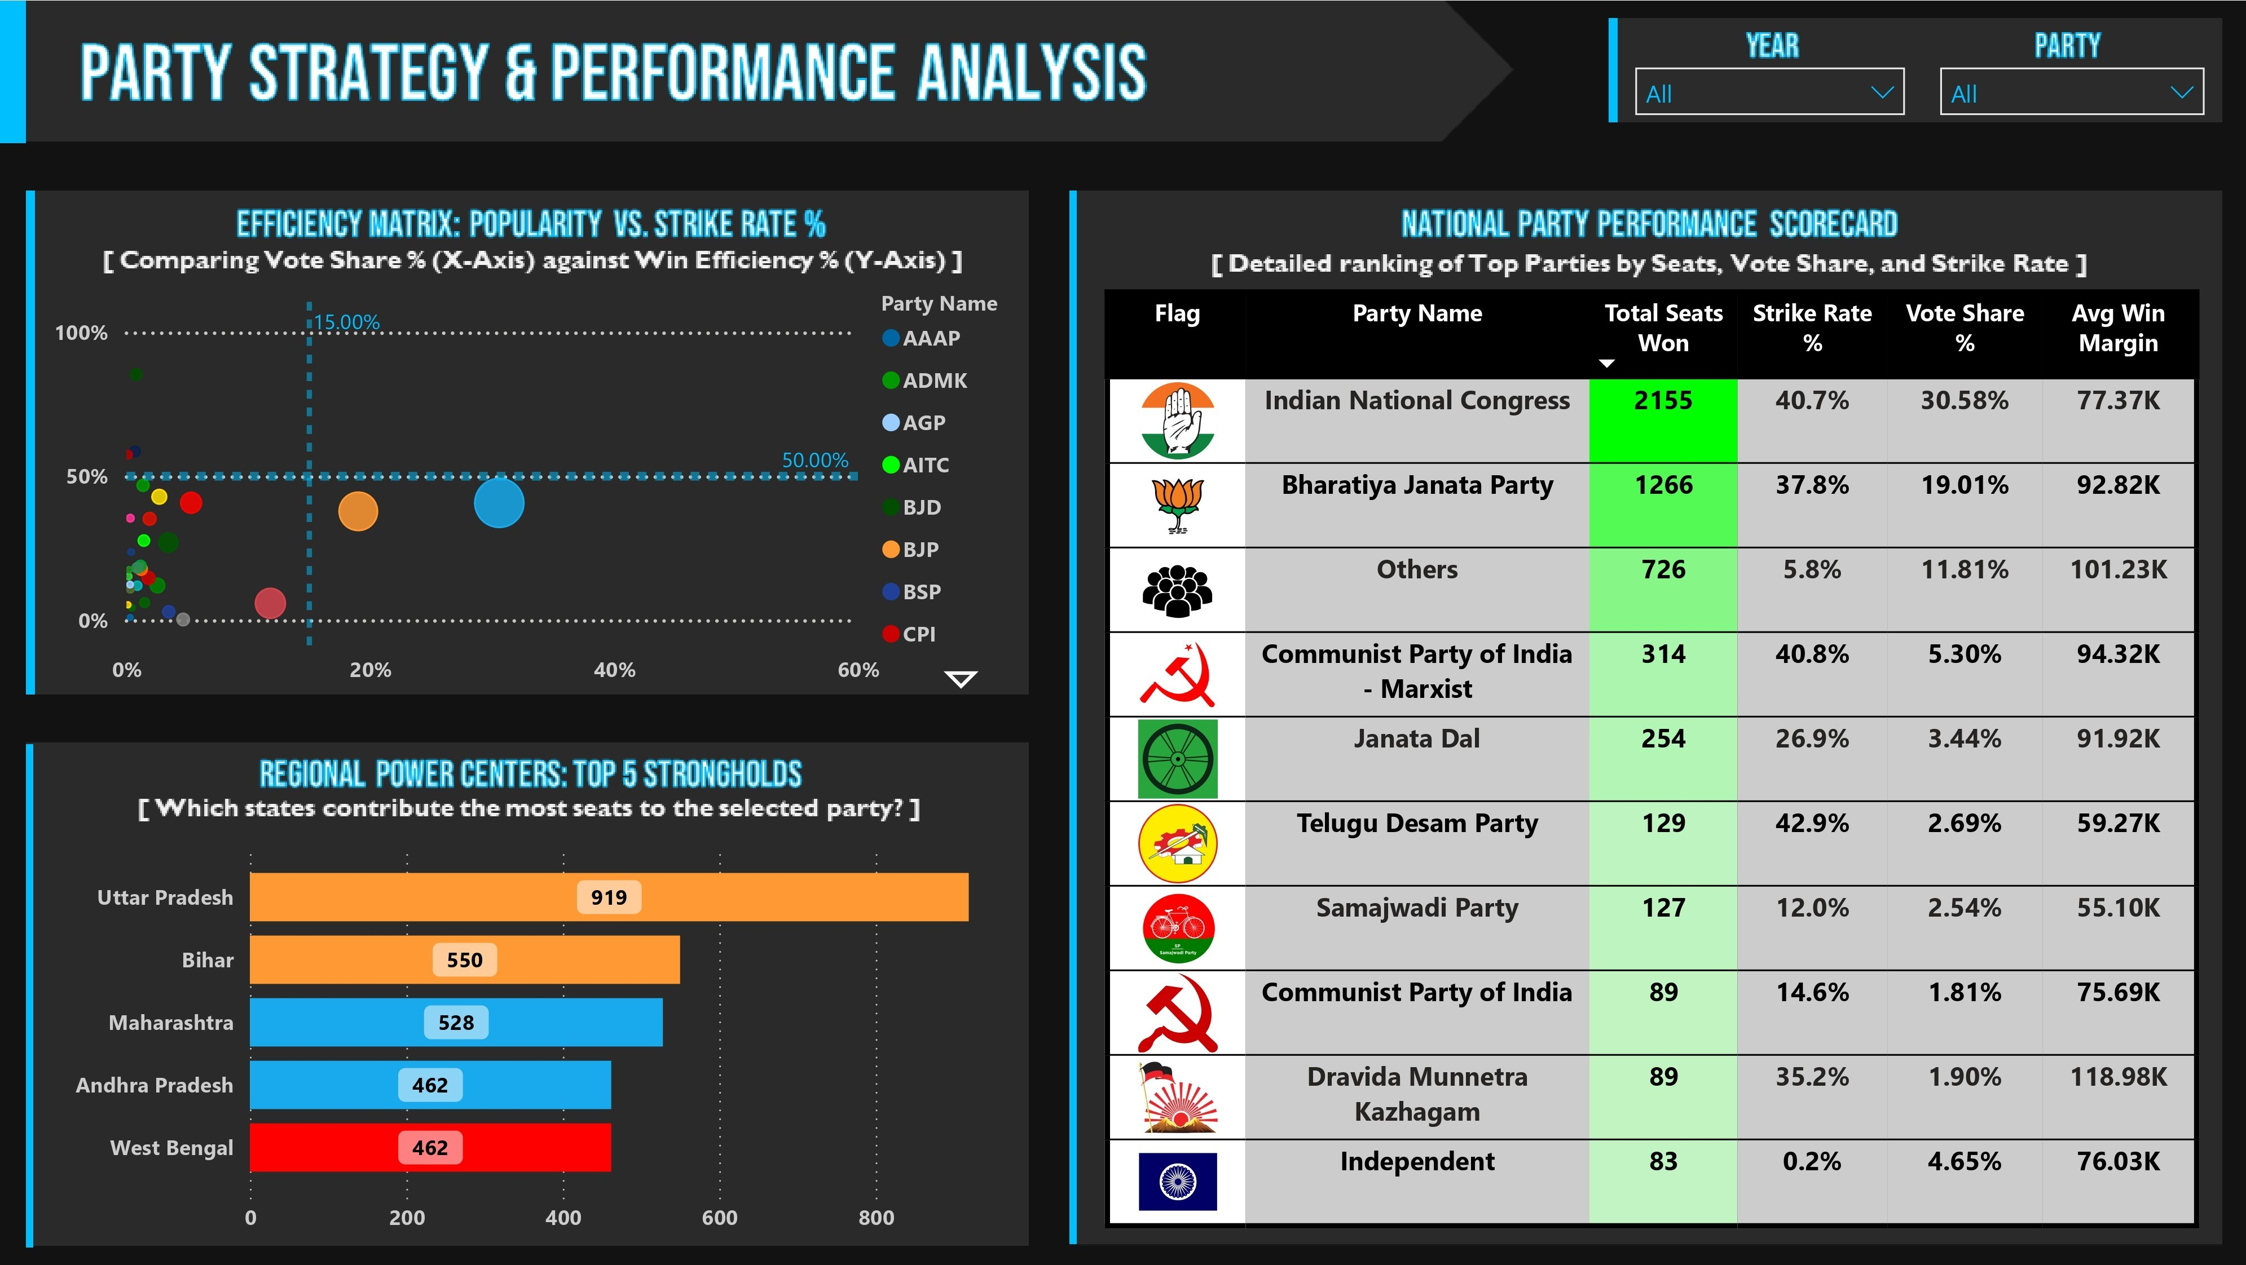
Module 3: Party Strategy & Performance
Theme: The ROI of Politics - Evaluate campaign efficiency beyond simple seat counts
Key Features:
Efficiency Matrix Scatter Plot
Performance Scorecard Table
Regional Power Centers (Top 5 States)
Vote-to-Seat Conversion Analysis
Party Base Identification

Slide 12

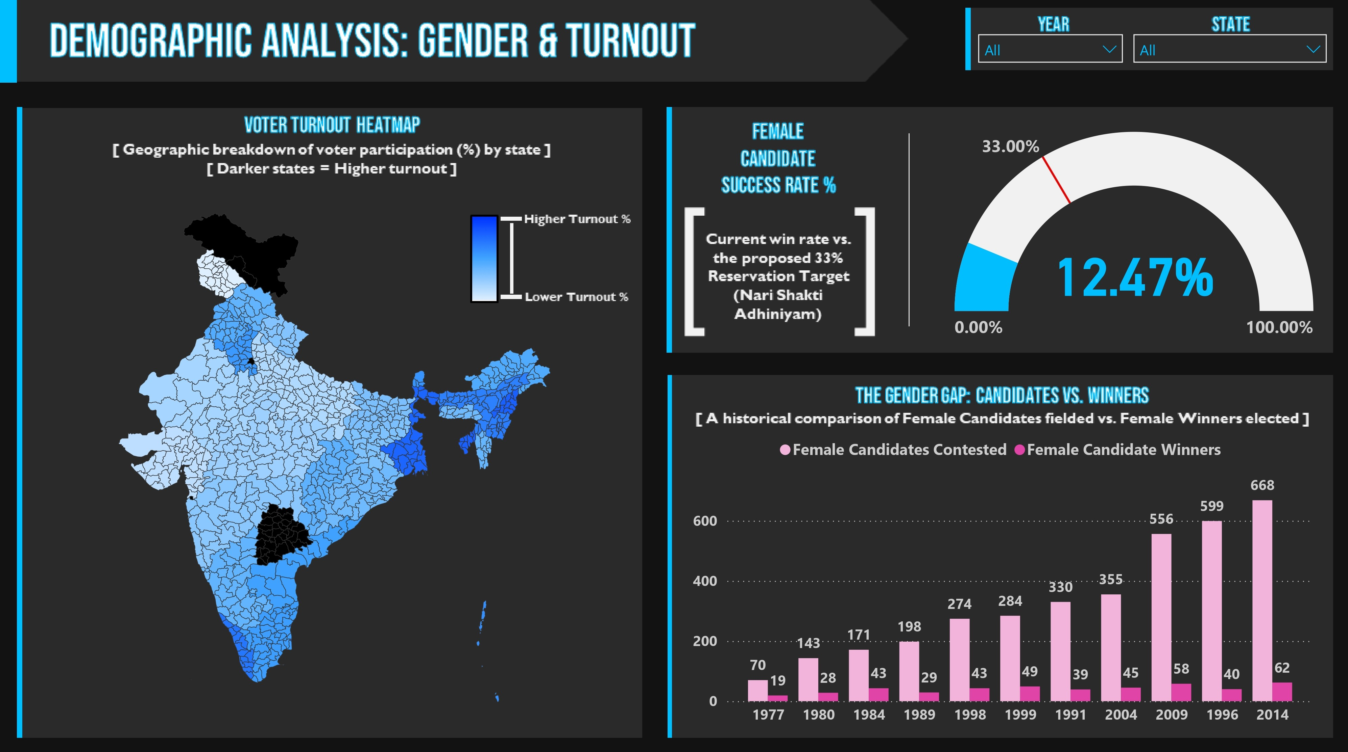
Module 4: Demographic Analysis
Theme: The Social Health Check - Analyze human element of elections - voter participation and gender inclusivity
Key Features:
Gender Gap Analysis (Candidates vs Winners)
Female Success Rate Gauge (33% benchmark)
Voter Turnout Heatmaps by State

Slide 13

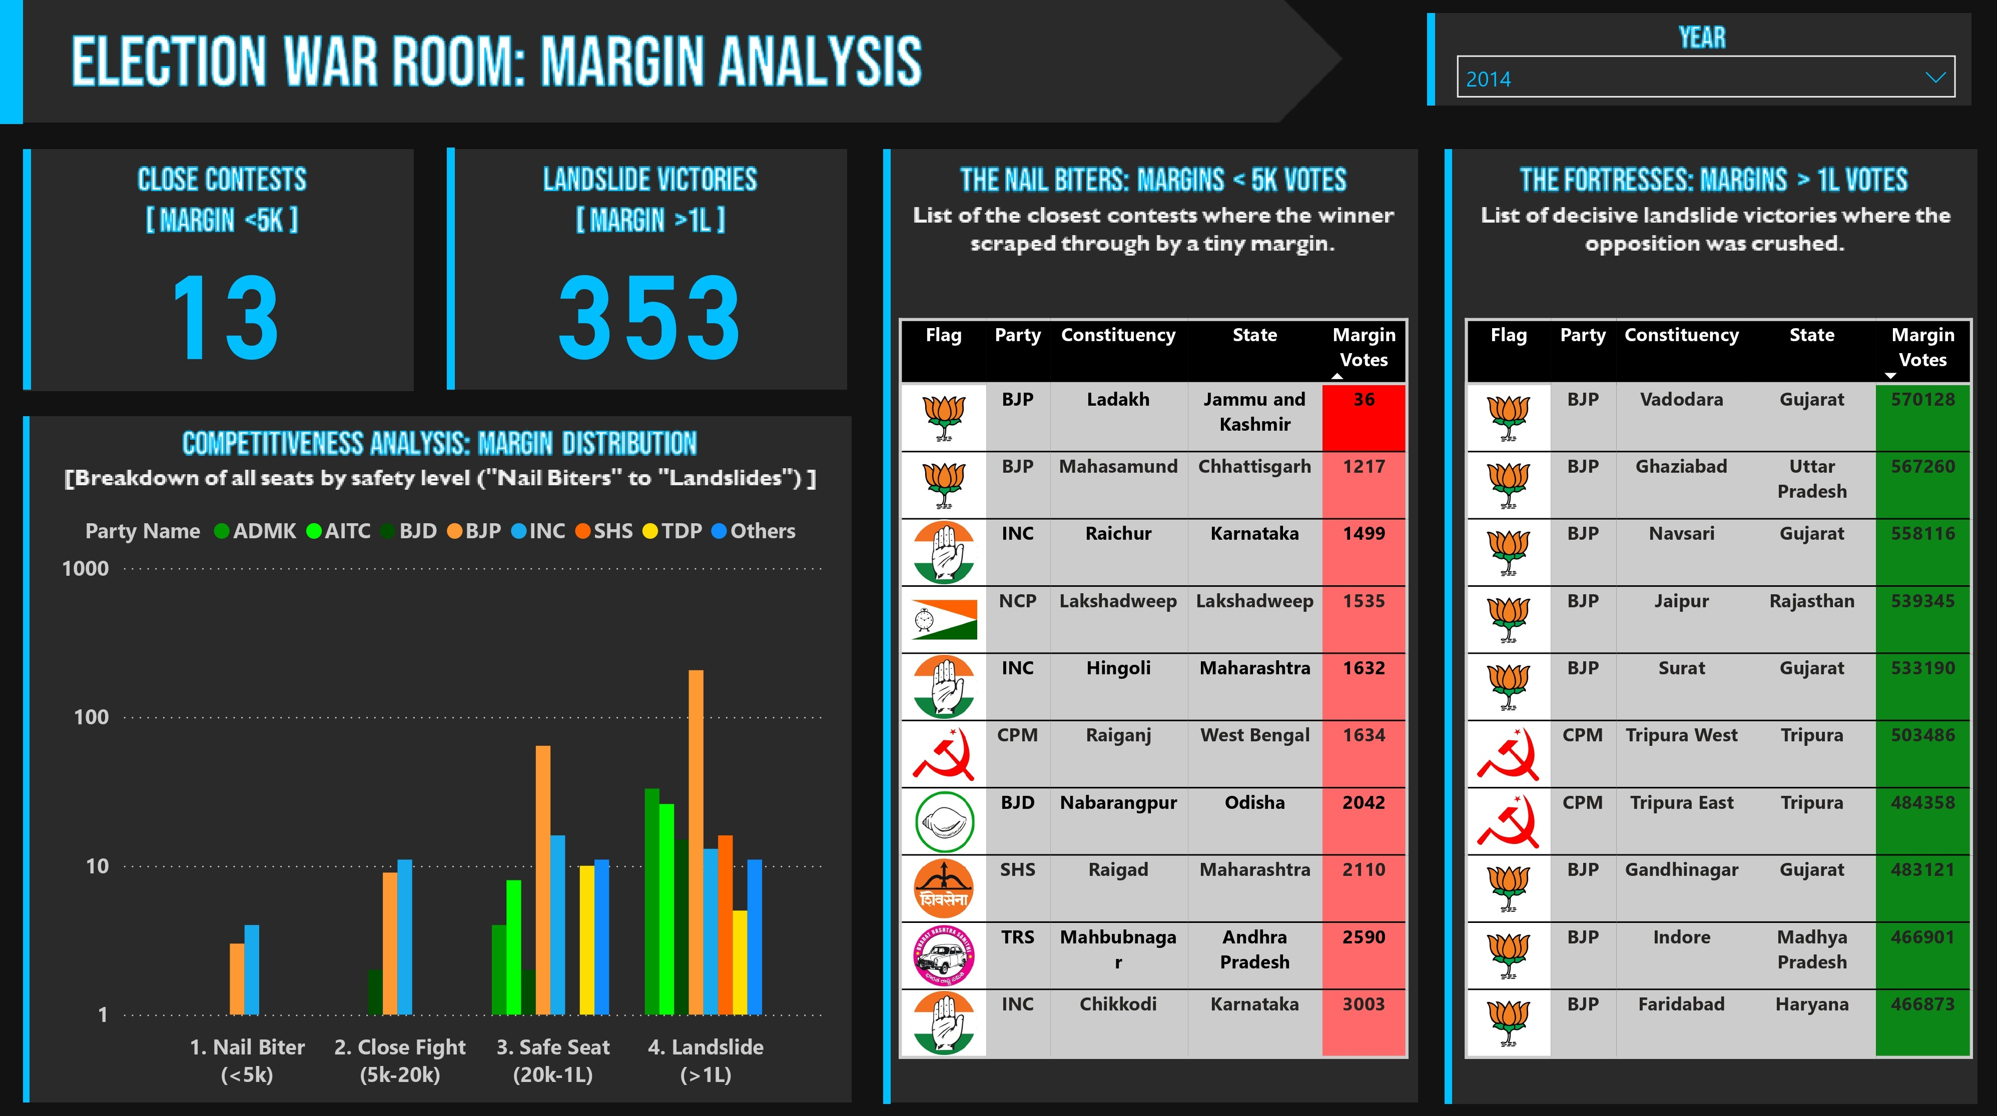
Module 5: Election War Room
Theme: Critical Alerts & Volatility - High-stakes command center for live reporting and margin analysis
Key Features:
Nail Biters Table (<5,000 vote margins)
Fortress Seats (>100,000 vote margins)
Competitiveness Analysis by Category

Slide 14

Testing & Validation
Rigorous testing phase ensuring system integrity:
Data Accuracy: Aggregate reconciliation confirming zero data loss
Edge-Case Validation: Testing smallest winning margins
Cross-Filtering Stress Test: Verifying filter propagation
Temporal Logic: Validating time-intelligence measures
Interactivity Testing: Confirming context transitions
25+ test cases executed successfully

Slide 15

Key Achievements
400,000+
Records Processed
28+
DAX Measures
5
Dashboard Modules
40
Years of Historicl Data
100%
Data Integrity
25+
Test Cases Passed

Slide 16

Challenges & Solutions
Challenges
▸Naming inconsistencies across 40 years
▸Missing derived metrics in raw data
▸Complex Galaxy Schema design
▸Performance with 400k+ records
▸Real-time filtering requirements
Solutions
✓Python-driven normalization pipeline
✓Custom DAX measure engineering
✓Optimized data modeling
✓Performance-tuned visualizations
✓Dynamic context filtering

Slide 17

TEAM CONTRIBUTIONS & ROLES
Team Member | Role | Key Contributions & Deliverables
Ashish Ransing | Group Leader | • Dashboard Architecture: Built the Command Center (Page 1) & State Analysis (Page 2). • UI/UX Lead: Finalized formatting, color themes, and navigation across all pages. • Tech Support: Assisted team with complex DAX logic.
N. Manjushri | Data Engineer | • ETL Pipeline: Handled Data Collection, Cleaning, and Transformation. • Data Modeling: Prepared the schema for Power BI ingestion. • Standardization: Fixed inconsistent party names/years via Python.
Varshita P. D. | Developer | • Strategy Module: Designed & Built Page 3 (Scatter Plots/Matrices). • Backend Logic: Developed 50% of the core DAX measures (Performance metrics).

Slide 18
TEAM CONTRIBUTIONS & ROLES
Team Member | Role | Key Contributions & Deliverables
Pratham S. Salian | Developer | • Demographics Module: Designed & Built Page 4 (Gender & Turnout analysis). • Backend Logic: Developed the remaining 50% of DAX measures (Demographic metrics).
Kanukanthi Deepika | Analyst | • War Room Module: Designed & Built Page 5 (Margin Analysis tables). • EDA: Conducted initial Exploratory Data Analysis to identify key trends.
Note: Technical Documentation and Reporting were collaboratively drafted with individual ownership of specific sections.

Slide 19

Conclusion
Synthesis: Successfully transformed 40 years of raw data (400k+ records) into a high-performance, broadcast-ready Command Center.
Innovation: Engineered "hidden" metrics like Strike Rate and Margin Categories to provide deep strategic insights.
Reliability: Achieved 100% Data Integrity through rigorous Aggregate Reconciliation and "Safe-DAX" error handling.
Media Value: Provides newsrooms with instant, actionable intelligence for live reporting on swings and mandates.
Final Status: 100% Complete and fully optimized deployed along with final documentation on GitHub.

Slide 20
Thank You !!

